Slide 1
Using Wax and Jekyll to build minimal digital projects
Jo Klein Cass Wilkinson Saldaña Angela Zoss (presenting)
Notes:
This tutorial is a brief overview of how to use Wax and Jekyll to build minimal digital projects. My name is Angela Zoss, and I’m happy to share this work done with my colleagues Jo Klein and Cass Wilkinson Saldaña.
I would also like to take a moment to acknowledge that my home institution, Duke University, gathers on land that has long served as the site of meeting and exchange amongst a number of Indigenous peoples, historically the Shakori (sha-core-ee) and Catawba (kuh-taa-buh) people.

Slide 2
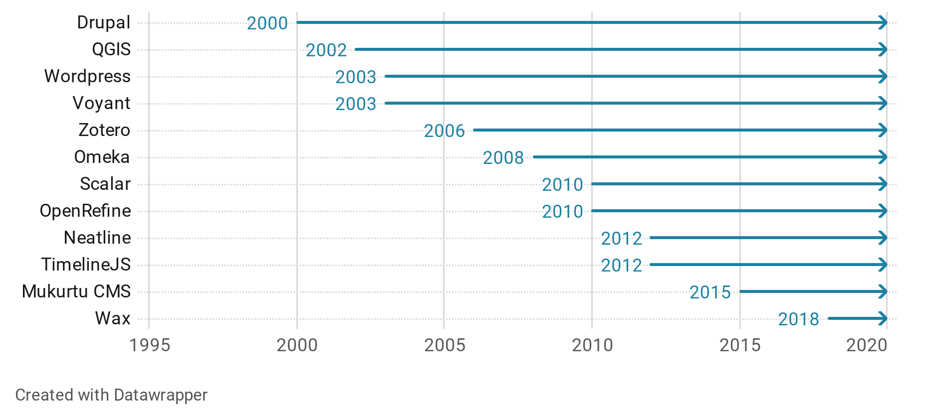
Open source digital scholarship tools over time
Notes:
Our focus on minimal digital projects today is part of a longer story of librarians and researchers building digital projects collaboratively. Over the years, how we collaborate on digital projects has changed -- from handcoded HTML websites, to services built on platforms like Wordpress.com, to projects spun up from locally hosted instances of software like Omeka. We’ve built up an ecosystem of mature open source platforms to support this work; as you can see here, many common platforms actually have their roots in projects begun a decade or more earlier.

Slide 3
“I prefer to approach minimal computing around the question “What do we need?”
...we aim to understand ways of building that could be referred to as architectures of necessity…”
“The User, the Learner and the Machines We Make” by Alex Gil (2015) via Minicomp
Notes:
In the mid-2010s, a community of developers in libraries emerged that grappled with ethos of building and maintaining. In this essay, Alex Gil proposed minimal computing as a way to tackle this critical question: what do we actually need in our digital projects? What would it look like to collaboratively build in a way that emphasizes precisely the architectures of necessity”?

Slide 4
What is Minicomp?
“Minicomp is a collaborative effort in embedding minimal computing principles (e.g. Minimal Maintenance, Minimal Dependencies, and Minimal Connectivity) in digital humanities methods.”
Minicomp Wiki
Notes:
Minimal Computing emerged as a nexus for digital scholarship practitioners in libraries. It proposed a path forward by utilizing “minimal computing principles”.

Slide 5
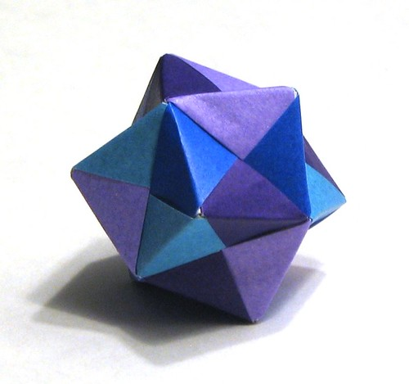
Minimal computing values in digital projects
Minimal:
Maintenance
Dependencies
Obsolescence
Maximum:
Access
Accessibility
Ephemerality
Minimal Definitions (tl;dr version), Jentery Sayers - 03 Oct 2016
"Origami stellated octahedron" by endolith is licensed under CC BY-SA 2.0
Notes:
Minimal computing provides a conceptual framework for building. It emphasizes creating sustainable projects by minimizing choices like software dependencies that propagate maintenance tasks in the future that eat up labor and resources.
We found the assertion of Maximum Ephemerality especially useful when thinking about a repository. Instead of imagining a repository as an eternal vault of content, “what if we make our collected materials extremely easy to access and build off of? What if we design with the eventual end of our project in mind?” If we take those goals to heart, we end up making very different decisions about how to build, use, and contribute to open source platforms.

Slide 6
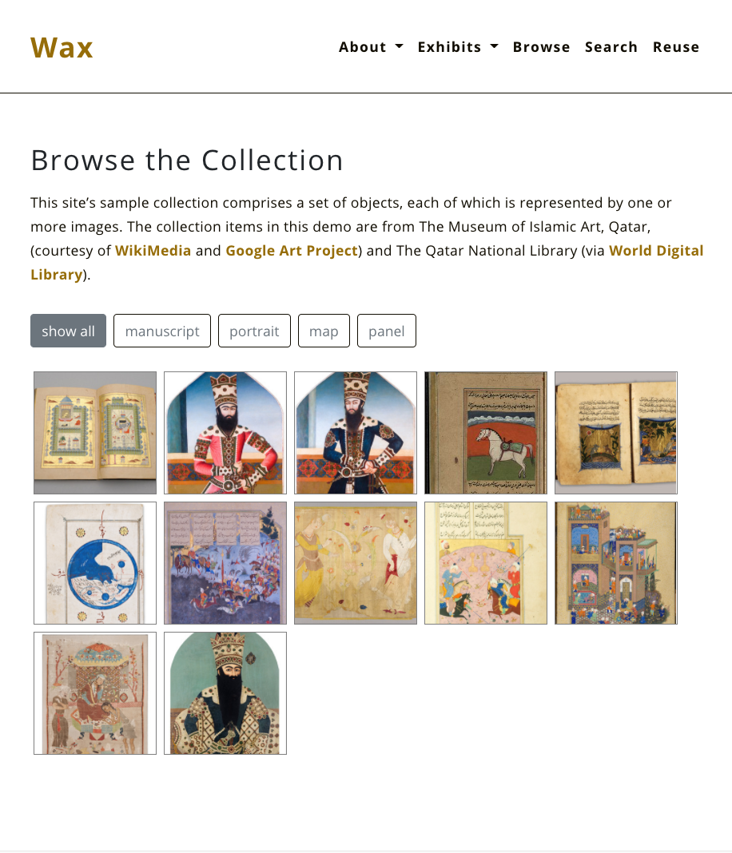
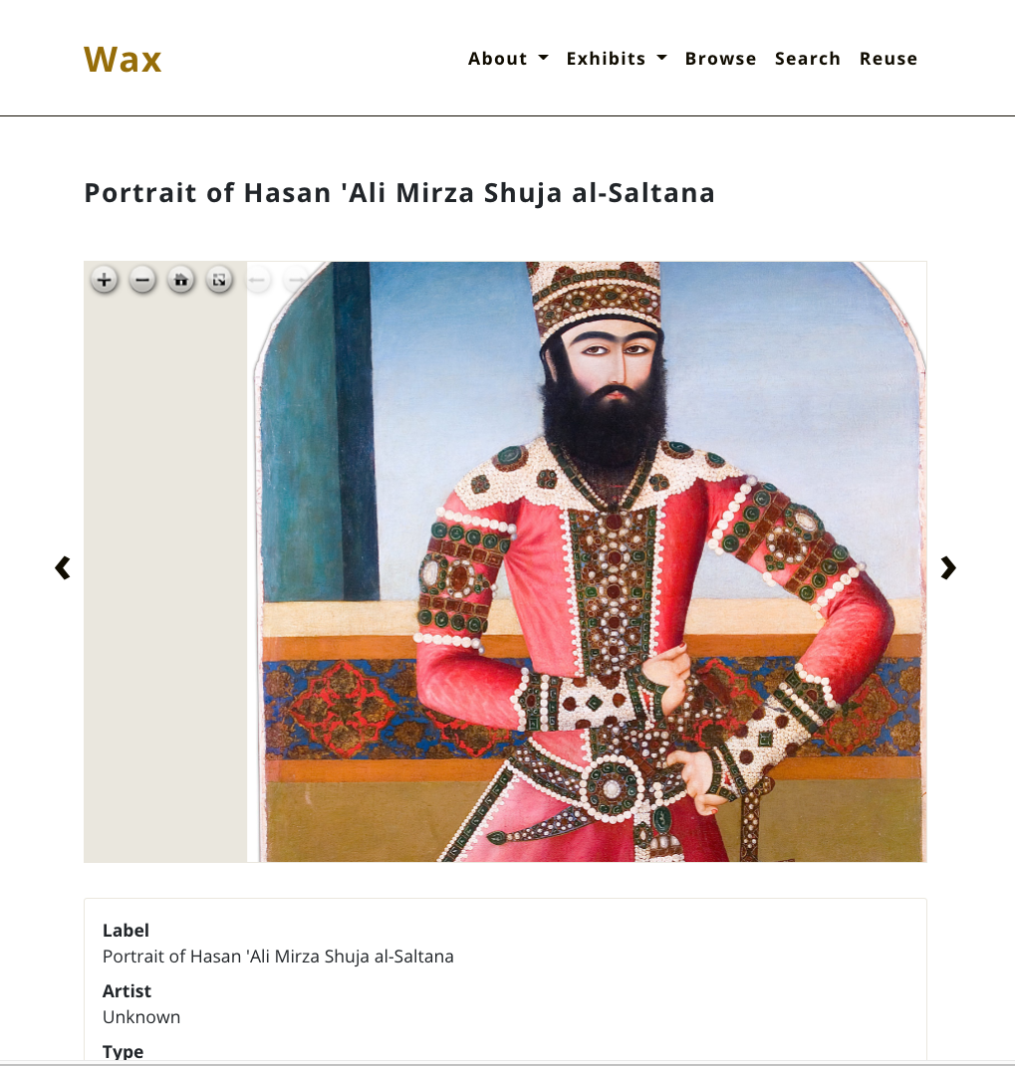
What is Wax?
Wax builds on an existing website platform to create minimal digital exhibits.
Notes:
Wax provided the key piece of software to make this all possible. In 2018, the Minicomp team released Wax as “a minimal computing project for producing digital exhibitions focused on longevity, low costs, and flexibility.” Wax provides the foundation for a wide variety of minimal projects, with a focus on digital exhibitions and image-driven digital exhibitions in particular.

Slide 7
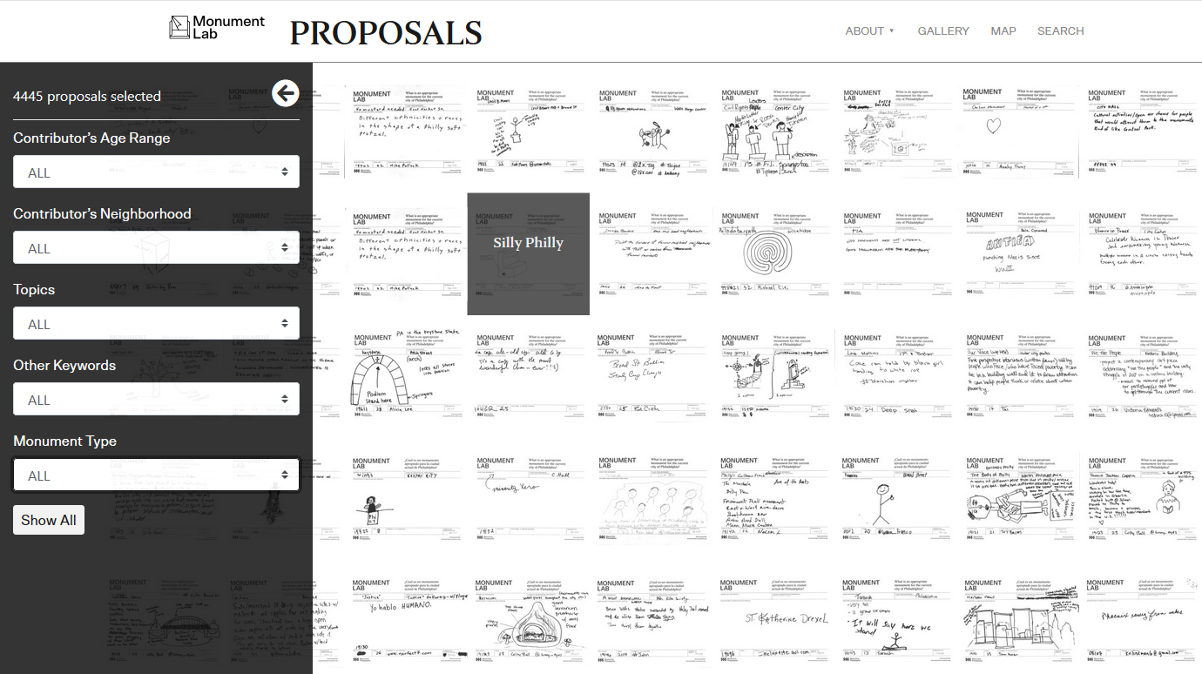
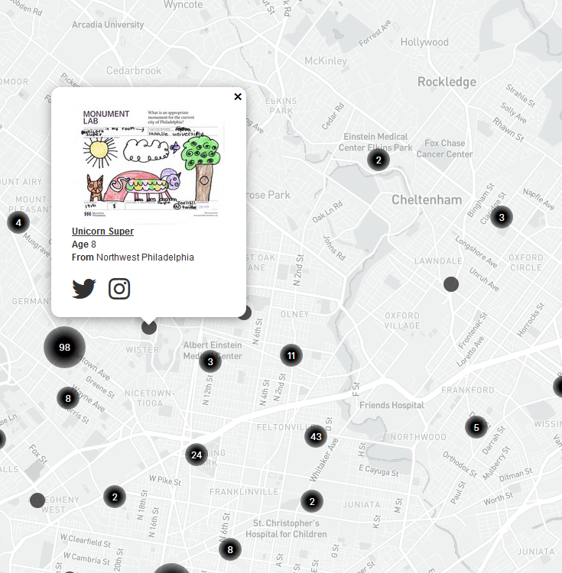

Proposals: Creative Speculations For Philadelphia
Monument Lab & Mural Arts Philadelphia
Notes:
One great example of how Wax can be used and extended is the Proposals project from the Monument Lab. This project shares the results of a participatory research project to explore monuments in Philadelphia. The project uses Wax to explore almost 4,500 proposals for new monuments, including a large thumbnail gallery and an interactive map of proposed monument locations.

Slide 8
How Does Wax Work?
Notes:
Now we’d like to share a bit more about how Wax works.

Slide 9

First, a note about Jekyll
Compiles plain text files into a full website
Built on Ruby
Has built-in concepts of pages, posts, and (important for Wax) collections
Notes:
To understand Wax, it’s important to start with a look at Jekyll. Jekyll is an open source website builder written in Ruby. Jekyll takes plain text files you write in simple formats like Markdown and compiles them into a full website.
Jekyll has built-in concepts for several very common website features, including pages and posts. Importantly for digital exhibits, though, Jekyll also makes it easy to create collections.
Jekyll collections are custom-defined groups of objects with shared metadata fields and relationships to other objects.
For example, if you’re using Jekyll to build a website that sells merchandise, you might have a single collection of all of your products, or you could build different collections for different types of products - a collection for shirts, a collection for mugs, etc. Each item in a collection, represented by a Markdown file, would have its own metadata and be associated with its collection.

Slide 10
Wax saw Jekyll as a good foundation for digital exhibits.
Storing objects
Displaying objects
Keeping it minimal
Notes:
When the Wax team went about trying to solve issues in digital humanities, they saw a need for a new way to spin up simple digital exhibits that fit well with the minimal computing philosophy. By selecting Jekyll as the base platform for Wax, the team took advantage of an existing framework with useful features, including features for storing objects, displaying objects, and keeping with the minimal computing philosophy.
When storing objects for a digital exhibit, Jekyll collections are a great fit. Each exhibit can become a collection, and exhibit items become collection objects. Jekyll handles the item metadata, and keeping the items in a collection makes other functionality much easier.
When displaying objects, for example, Jekyll collections make it easy to iterate over exhibit items to pull all of them into a single page display. Instead of having to hard-code in every single item separately, Jekyll makes it trivial to write loops over all collection items.
Finally, Jekyll itself fits nicely with the minimal computing philosophy. It is a platform that: has basic features, is easy to learn, is well maintained by an active community, and is well integrated with a free web hosting platform - namely, GitHub pages.

Slide 11
Wax helps prepare digital exhibits for Jekyll.
Processing images
Generating item pages
Adding search functionality
Notes:
Jekyll out of the box is a very general website builder, so Wax extends Jekyll’s capabilities to tailor it for digital exhibits. One way Wax extends Jekyll is by helping to prepare digital exhibit assets for the Jekyll way of building websites.
Wax has three preparation steps it undertakes to get your exhibit files ready for Jekyll.
The first step is to process the raw images of items in the exhibit. Wax can produce either simple thumbnails of the images or create IIIF derivatives for a more advanced display of the item.
The second step is to generate item pages. Jekyll requires that each collection object has its own Markdown file, but for large exhibits, creating pages individually can be very tedious. Instead, exhibit creators can build a single spreadsheet of exhibit item metadata, and Wax will process that file into individual Markdown files for Jekyll.
The final step is to add search functionality to Jekyll. Jekyll doesn’t have a native search feature, so Wax includes its own search functionality, as well as a simple processing step that prepares the exhibit item metadata for the search.
Wax supports these three preparation steps by using something called “rake tasks.” Rake works in Ruby to automate tasks.
Let’s look a bit more closely at how Wax processes and generates exhibit files using these tasks.

Slide 12
Wax image processing
Wax rake task
wax:derivatives:simple
wax:derivatives:iiif
_data directory
_config.yml
custom directory
_data directory
Jekyll site source files
raw images
name of raw image directory, metadata file, default layout
img
metadata file
Notes:
The rake tasks used by Wax to process exhibit files basically pull from and write to the Jekyll site source files. In this slide and the next few slides, we’ll explore each task to see what the inputs and outputs are.
The first Wax data processing step is image processing. For image processing, you first store the raw images in a special directory named “_data”, inside a subfolder named for the collection. You will also update the Jekyll configuration file by adding the name of the image directory, as well as other defaults for the collection like the default layout. You use the command line to run one of the Wax rake tasks for image processing (either the “simple” version or the “IIIF derivatives” version).
The rake task will look for the raw images based on the specifications in the configuration file. It then generates the requested image derivatives and stores them in a custom directory called “img”. Finally, it updates your metadata file to include the paths to the image derivatives and additional helpful information, such as the collection name and the default layout from the configuration file.

Slide 13
Wax page generation
Wax rake task
wax:pages
_config.yml
_data directory
_collection directories
Jekyll site source files
name of metadata file
metadata file
Markdown pages
Notes:
The second Wax task is to generate item pages. Wax does this by finding the name of the metadata file in the configuration file, pulling the metadata for each item out of that file, and converting it to individual Markdown files for each item. The metadata fields and values are included in the file’s header section, called a YAML (why-ey-em-ell) header. The Markdown files are now ready for Jekyll to build a collection out of the items.

Slide 14
Wax search functionality
Wax rake task
wax:search
_config.yml
_collection directories
custom directory
Jekyll site source files
search properties
Markdown pages
search
Notes:
The third Wax task is to support Wax’s added search functionality. This task looks for search properties in the configuration file, pulls in the metadata from all of the new item Markdown files, and outputs a single file with all of the searchable metadata fields and values across all collection items. This file gets stored in a custom “search” directory that is then used by Wax-created pages in the final Jekyll site.

Slide 15
Special pages that come with Wax
Notes:
Jekyll creates a website from a series of pages, templates, and configuration settings. After the Wax tasks have been run, the collection content is now ready for Jekyll, but the content needs special kinds of pages to show off the collection items and provide useful functionality.

Slide 16
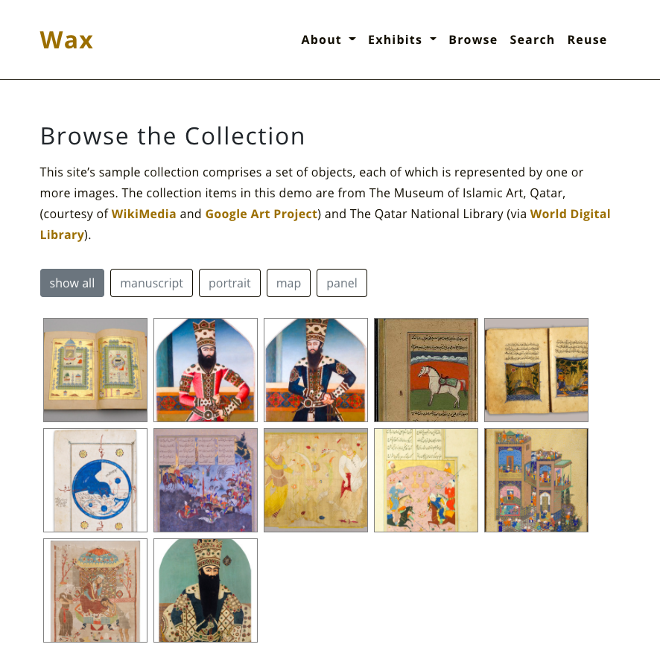
“Browse” pages/include
Repository has a page called “collection”
Collection page uses an include called “collection_gallery”:
pulls in collection metadata
builds an image gallery
adds filter buttons at the top
Notes:
One type of page that comes included with the Wax repository is a “browse” page - a page that allows someone to browse all exhibit items at once, seeing a grid of thumbnail images. The Wax repository includes an example browse page, which specifies a particular sample collection. This page calls something called an “include”, which is a kind of template that can be designed to take a few parameters so it can be reused in multiple places across a website. The gallery include takes the name of the collection and the name of a metadata field. It then sets up the thumbnail gallery for each item in the collection and adds a filter at the top of the page based on the metadata field specified.

Slide 17
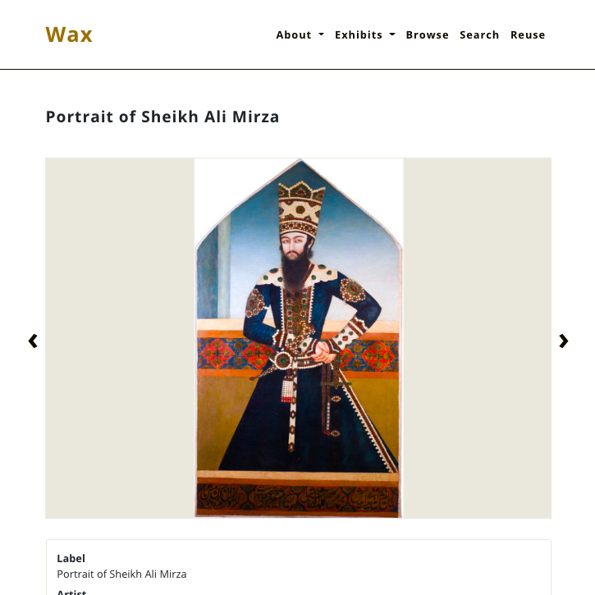
“Item” pages/layout
Wax task creates item pages, including default layout from configuration file
Repository has layout called “generic_collection_item”
image viewer at the top
table of metadata at the bottom
Notes:
Another type of page that comes included with the Wax repository is an “item” page. To be more accurate, the Wax page task already created our item pages, but Wax offers a special “layout” to help with the design of the the item pages. In Jekyll, a layout determines how the header and content sections of a Markdown file get converted into a web page. The Wax repository includes a layout called “generic_collection_item,” and this can be added to the configuration file as the default layout for a collection’s item pages. The layout sets up an image viewer at the top of the page and a table of metadata fields and values at the bottom of the page.

Slide 18
Easiest Wax Project
Download files from the Wax demo repository
Create a .csv and add to _data folder
Create raw images and add to _data/collection folder
Edit configuration file to add collection info, search info, other site information
Run Wax tasks
Edit Jekyll pages to update content for current project
Create a GitHub repository using files
Set up GitHub Pages for hosting
Notes:
What does it really take to get Wax up and running? Let’s say you want the simplest and quickest digital exhibit possible.
First, you will download the files from the Wax demonstration repository on GitHub. Next you’ll start replacing the demo exhibit files with your own files, including your metadata file and raw images. You will edit your configuration file to change the collection, search, and site information to match your project. At this point, you can run the Wax tasks to process your images and metadata and create the search index. You can then edit the remaining pages to replace the Wax demo page content with your own. Finally, you will take your files and create a GitHub repository for them, setting up the GitHub Pages functionality to have GitHub build and host the site for you.
<click to advance animation>
Note that several of these steps require some moderately advanced technical skills. In particular, we feel it may be useful to have skills in installing the kinds of software used by Jekyll and Wax - for example, Ruby with the bundler gem and ImageMagick for Wax’s image processing tasks.
Running the Wax tasks happens on the command line, so having some comfort running and troubleshooting command line commands is also useful.
Finally, if you are using GitHub to host the exhibit site, it is helpful to have some experience setting up GitHub Pages and updating the code files in the GitHub repository, either through the command line or using desktop software like GitHub Desktop.

Slide 19
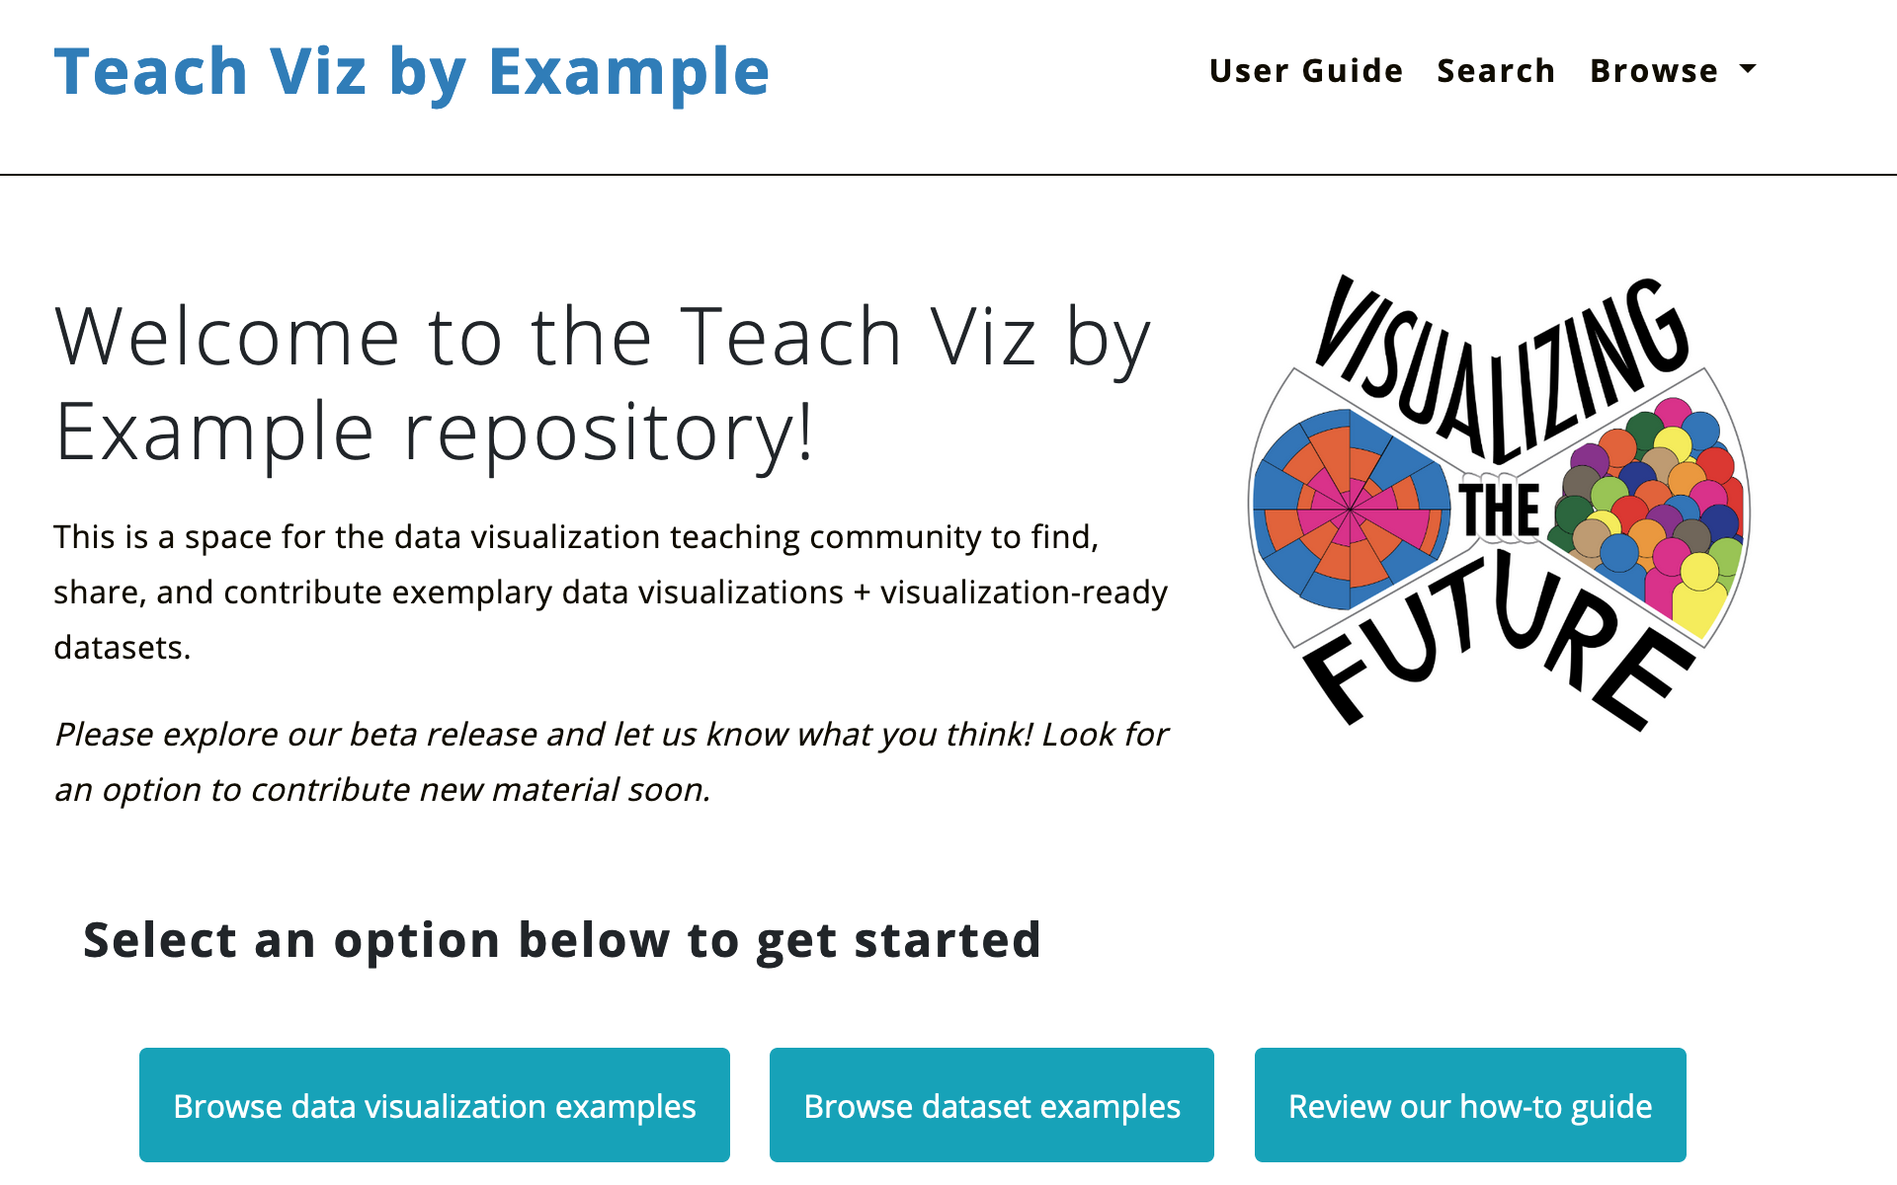

Sample Project: Teaching Viz By Example
This project was made possible in part by the Institute of Museum and Library Services, RE-73-18-0059-18.
Teach Viz by Example
Notes:
To show you an example of what you can do with Wax, we’ll dive in to a project called Teaching Viz By Example, which uses Wax to build a repository of visualization and dataset examples for instructional purposes. This project was made possible in part by a National Forum grant from the Institute of Museum and Library Services.
Searching for example visualizations or datasets that are appropriate for teaching, especially for short-form library instruction, can take a lot of time. Furthermore, existing places where data are shared do not necessarily capture the information that would be useful to evaluate the visualization or dataset. We saw a need for a repository really tailored to sharing and finding datasets and visualizations designed for teaching.

Slide 20
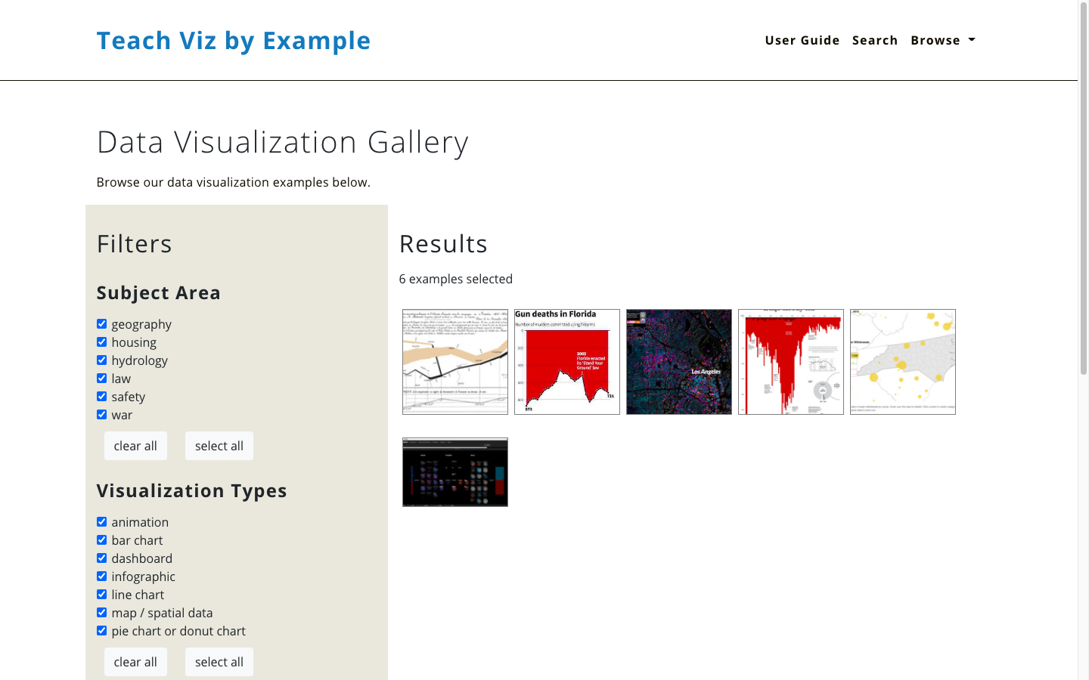
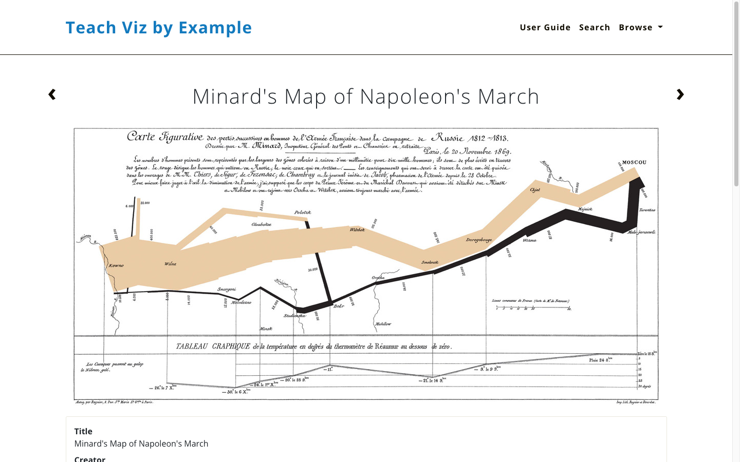
Why Wax?
Minimal computing philosophy
Lightweight, easy to update and maintain
Host for free on GitHub
Open to some programming
Notes:
Wax, while designed for digital exhibits, has many of the features we were looking for in a repository designed for highly visual content. We felt the minimal computing philosophy was an excellent fit for our project, situated as it is in libraries. We knew we would need something easy to deploy and maintain to promote sustainability. We felt that GitHub would be an ideal hosting platform, both for the ability to share code and for the ability to host without any fees. Finally, as a team, we were open to tools that would require light programming and command line processing.

Slide 21
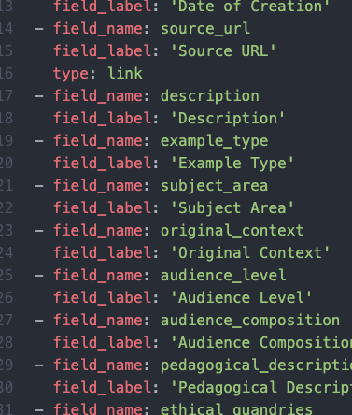
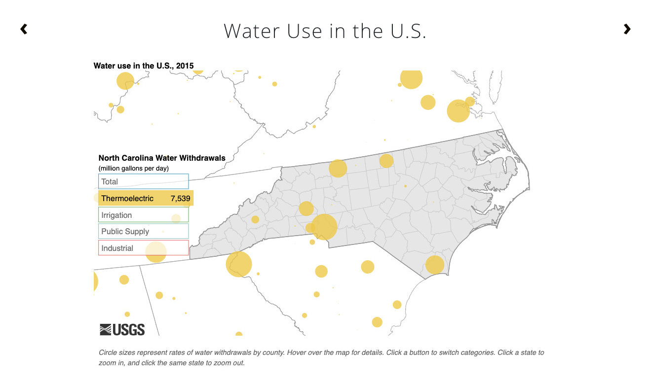
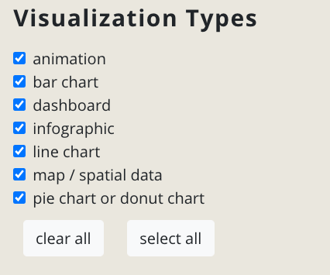
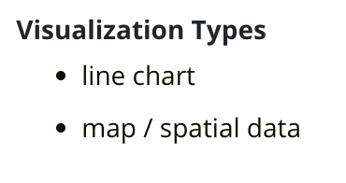



How we are extending Wax
Lists in fields
Multi-facet filters
Data dictionary
Linked
items
Notes:
While Wax gave us a great starting point, we found a few features requested by our stakeholders were not already supported in Wax.
First, we wanted to support metadata fields that would naturally contain lists, like visualization types or data types. We use custom scripts to produce a metadata file that preserves the lists during the Wax page creation task.
The default Wax gallery offers a filter restricted to a single option from a single field. We have build a new page template that offers checkbox filters for multiple fields.
We recognize that data documentation is not only best practice but can also improve the design of a site. We have added a data dictionary that works with our pages to improve field labels and formatting.
Finally, because items in our collections can relate directly to each other, we have created a custom field type that allows items to link to an arbitrary number of other related items.
Our GitHub repository, linked at the end of our slide deck, includes the code for all of these features..

Slide 22
Resources for learning more
Our grant and project work
Visualizing the Future
Examples Repository GitHub
Sample Google Apps Script for list processing
Python processing script
More on Jekyll
Why Use a Static Site Generator?
Main Jekyll Documentation
Liquid Template Language
Writing and Maintaining Code
Free code editors: Atom, Visual Studio Code
GitHub Desktop to maintain GitHub repository
Creating a GitHub Pages site with Jekyll
More on Wax
Wax wiki = ample resources to create your own instance
Minimal computing for image collections: the case of wax by alex gil, marii nyrӧp @ DLF2018 Minimal Computing Panel
Advanced but useful
Bootstrap for website layout
JQuery for website functionality
Ruby, if you want to go really deep
Notes:
We have compiled a list of resources that may be helpful to learn more about Wax and Jekyll. Please see the shared copy of our slides to access these and other links included in this presentation.

Slide 23
Thank you!
Email us at visualizingthefuture@umich.edu
Notes:
This concludes our short tutorial on using Wax and Jekyll to build minimal digital projects. Please reach out if you have any questions or suggestions!

